Slide 1
Chemistry Genealogy
An academic genealogy web application

Slide 2
Purpose
Allow members of the academic and professional communities to explore – through search and data visualization -- the academic lineages uploaded by the application users.
Provide the administrator tight controls over data submission.

Slide 3
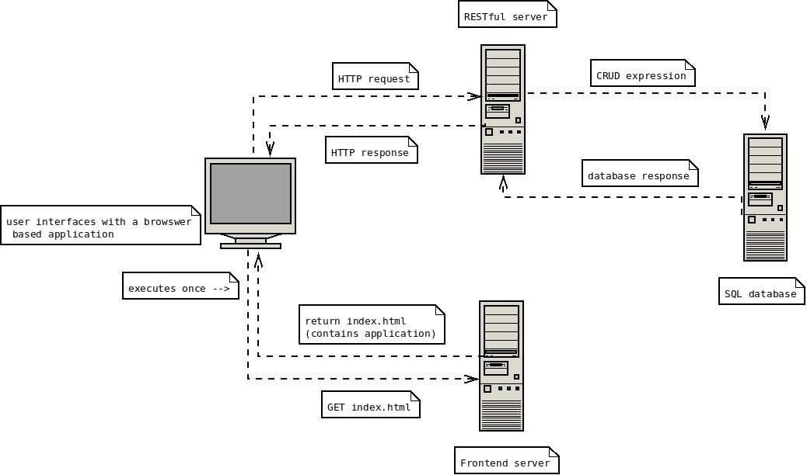
Architecture
Application architecture follows a model that should be familiar to anyone that has exposure to web application development.

Slide 4
Frontend
An Angular application using the Angular Material framework.
Angular provides an easy to understand MVC framework with many bells and whistles -- $q, $http, $broadcast.
Angular Material brings a material design UI framework that has “built in” responsiveness.
D3.js is used for the visualizations – strong library with many “plugin” libraries.

Slide 5
Backend
A Rails application using the ‘rails-api’ gem.
Controllers render JSON instead of HTML
Provides a smooth workflow and strong opinionated framework.

Slide 6
Database
SQLite provides an embeddable database with a familiar query language.
Rails allows for a “plug and play” approach to databases, so that if the embedded nature of SQLite caused a performance issue a “real” database (PostgreSQL) could be swapped in and the data migration should be relatively straightforward.

Slide 7
Search & Visualization
A user can search for a person to find all of their academic relationships. The relationships covered are postdoc mentors + mentored and degree supervisors and supervisions.
The searchbar provides autocomplete or suggestions.
D3 provides a visualization
User can view a person’s detail and explore relationships

Slide 8
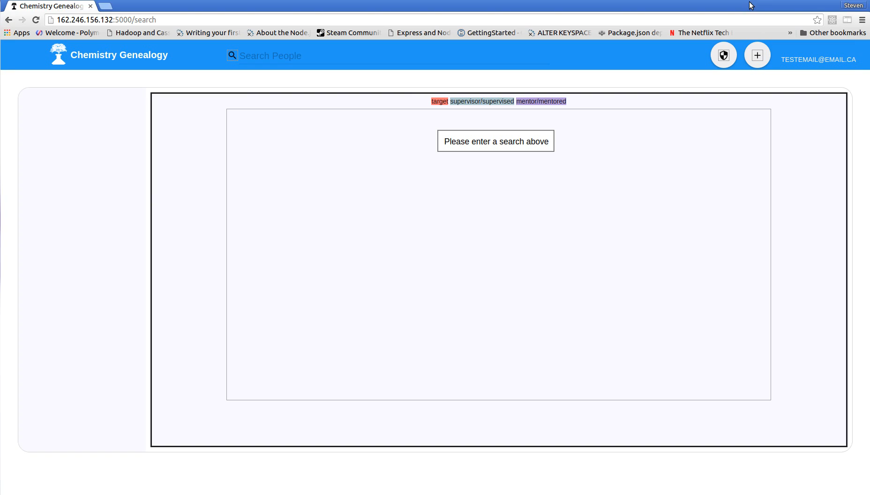
Screencast of search + detail

Slide 9
Challenges and solutions
Autocomplete is difficult to implement… Google it!
Angular-Material provides an md-autocomplete directive use it! Source
The visualization controller and the search controller both need access to the same dataset (search results), but they are not nested and were developed independently. Solution: broadcast It and recieve it
Data is in a relational database and to gather all data about one person for the view can require cumbersome SQL queries. Solution: active records

Slide 10
Admin notifications
The client wants to approve all submitted data.
Users with administrator privileges can navigate to an admin route that will detail new information
Administrator can then inspect the unapproved data before allowing it into the “searchable” pool.

Slide 11
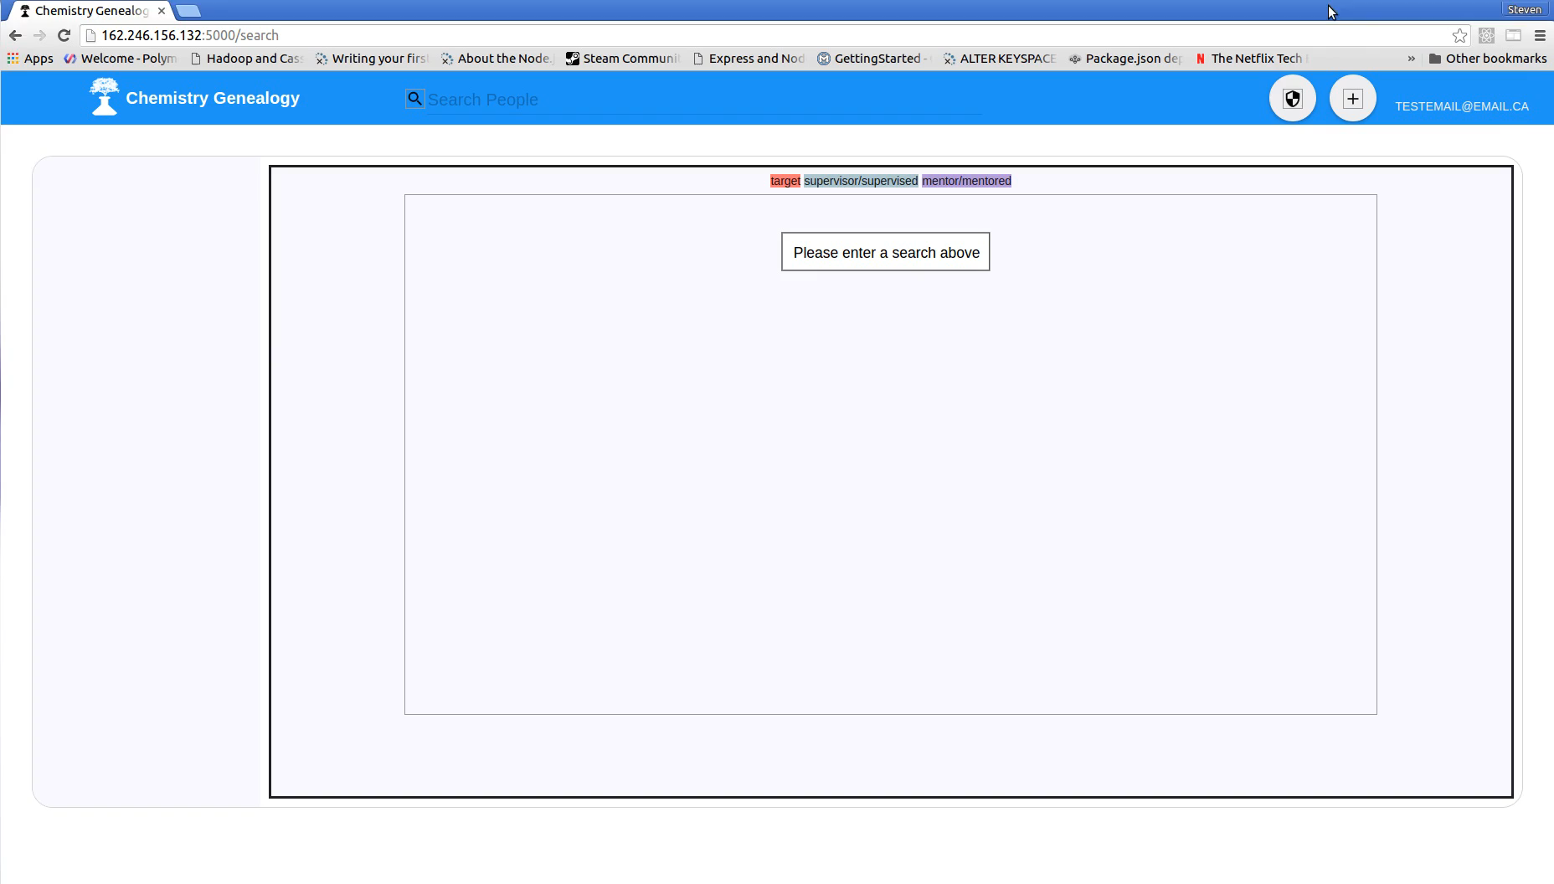
Notification + admin sceencast

Slide 12
Challenges and solutions
How to differentiate between approved an unapproved data? Solution: add an approved Boolean value and put an index + require restriction on it.
How to load unapproved mentorships, unapproved supervisions and unapproved people without duplicating data? Solution: gather all notifications and use a ‘WHERE id not in (…)’ system.

Slide 13
Lessons learned
Javascript event loop is a different model of programing than one is accustomed to. Example
Angular directives are a great way to encapsulate a web element. example_part1 example_part_2 example_part3
Rails ActiveRecord is an amazing ORM
npm dependencies can change change version… sometimes you need may need to specify specific versions, but is this a best practice?

Slide 14
What should’ve been done differently or what next?
Rewrite frontend in Angular 1.5.x using a componentized methodology in TypeScript -> progression towards Angular 2 and cleaner frontend.
The only real use of the Rails API is to interact with the database… get rid of it and use some type of Dbaas coupled with authentication -> deployment = webpage, no server to deal with. What if I need to access sometype of service? (mailer, image resizer or something similar) -> amazon lambda, azure functions or cloud functions. The days of deploying a server for small scale web applications are hopefully nearing an end.
Make a real production/deployment workflow.
Autocomplete without a %val% (one wildcard).

